Slide 1
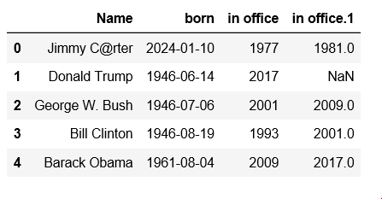
Index
Column Values
Column names
Row

Slide 2
Column
name
Index Axis=0
Aka Row Axis
Index Name
Index Axis = 1,
Aka Column Axis
Missing data
Index Lables
Row values
Column Values

